Slide 1
Introduction to Software Engineering
CSSE3113

Slide 2
What is UML and Why we use UML?
UML → “Unified Modeling Language”
Language: express idea, not a methodology
Modeling: Describing a software system at a high level of abstraction
Unified: UML has become a world standard
Object Management Group (OMG): www.omg.org

Slide 3
What is UML and Why we use UML?
More description about UML:
It is a industry-standard graphical language for specifying, visualizing, constructing, and documenting the artifacts of software systems
The UML uses mostly graphical notations to express the OO analysis and design of software projects.
Simplifies the complex process of software design

Slide 4
What is UML and Why we use UML?
Why we use UML?
Use graphical notation: more clearly than natural language (imprecise) and code (too detailed).
Help acquire an overall view of a system.
UML is not dependent on any one language or technology.
UML moves us from fragmentation to standardization.

Slide 5
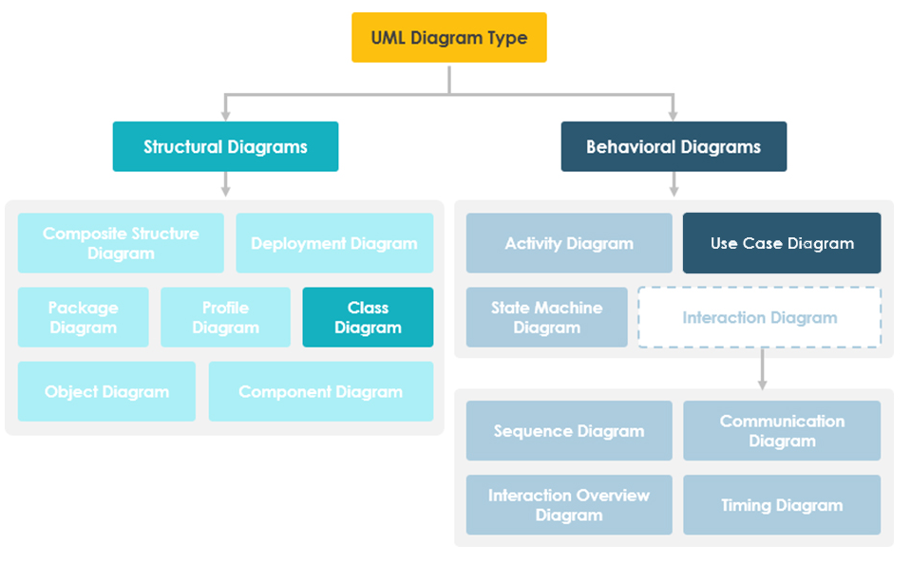
https://www.visual-paradigm.com/guide/uml-unified-modeling-language/what-is-class-diagram/

Slide 6
What UML Modeling tools
List of UML tools http://en.wikipedia.org/wiki/List_of_UML_tools
ArgoUML: http://argouml.tigris.org/
Rational Rose (www.rational.com) by IBM
UML Studio ( http://www.pragsoft.com/) by Pragsoft Corporation:
TogetherSoft Control Center; TogetherSoft Solo (http://www.borland.com/together/index.html) by Borland

Slide 7
Petri Nets
A form of state-transition notation that is used to model concurrent activities and their interaction
Circles (places) represent activities or conditions
Bars represents transitions
Arcs connect a transition with its input places and its output places
The places are populated with tokens, which act as enabling conditions for the transitions
Each arc can be assigned a weight that specifies how many tokens are removed from arc's input place, when the transition fires

Slide 8
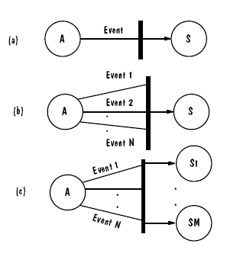
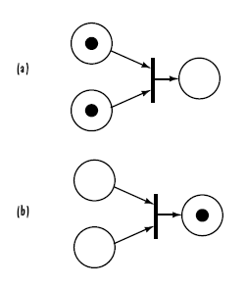
Petri Nets
Three types of transitions
Tokens

Slide 9
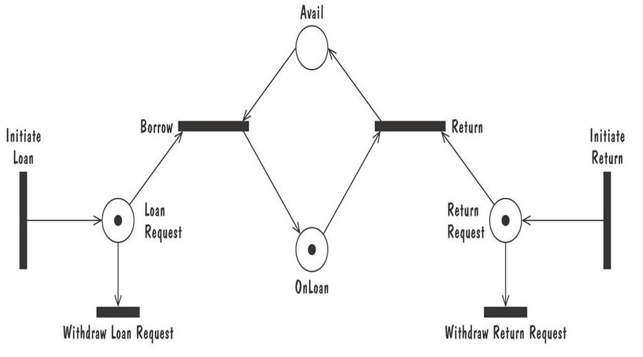
Petri Nets Example of Book Loan
Enabled Transitions:
Return
Withdraw Return Request
Borrow
Withdraw Loan Request

Slide 10
Petri Nets Example of Book Loan
Firing Transition
Return
Tokens removed
Return Request
OnLoan
Tokens inserted
Avail

Slide 11
Event Traces
A graphical description of a sequence of events that are exchanged between real-world entities
Vertical line: the timeline of distinct entity, whose name appear at the top of the line
Horizontal line: an event or interaction between the two entities bounding the line
Time progresses from top to bottom
Each graph depicts a single trace, representing one of several possible behaviors
Traces have a semantic that is relatively precise, simple and easy to understand

Slide 12
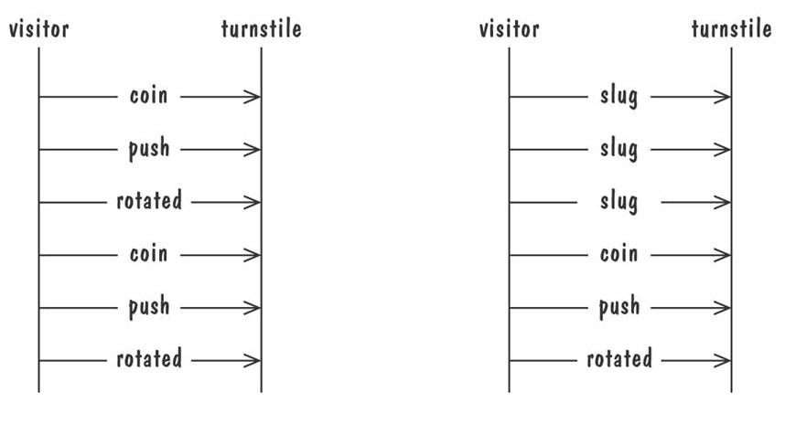
Event Traces
Graphical representation of two traces for the turnstile problem
trace on the left represents typical behavior
trace on the right shows exceptional behavior

Slide 13
Event Traces: Message Sequence Charts
An enhanced event-trace notation, with facilities for creating and destroying entities, specifiying actions and timers, and composing traces
Vertical line represents a participating entity
A message is depicted as an arrow from the sending entity to the receiving entity
Actions are specified as labeled rectangles positioned on an entity's execution line
Conditions are important states in an entity's evolution, represented as labeled hexagon

Slide 14
Sequence diagrams
Sequence diagrams are part of the UML and are used to model the interactions between the actors and the objects within a system.
A sequence diagram shows the sequence of interactions that take place during a particular use case or use case instance.
The objects and actors involved are listed along the top of the diagram, with a dotted line drawn vertically from these.
Interactions between objects are indicated by annotated arrows.

Slide 15
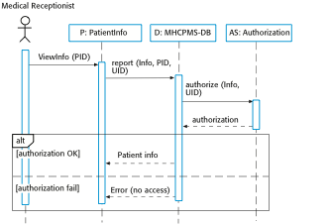
Sequence diagram for View patient information

Slide 16
Entity-Relationship Diagrams
A popular graphical notational paradigm for representing conceptual models
Has three core constructs
An entity: depicted as a rectangle, represents a collection of real-world objects that have common properties and behaviors
A relationship: depicted as an edge between two entities, with diamond in the middle of the edge specifying the type of relationship
An attribute: an annotation on an entity that describes data or properties associated with the entity

Slide 17
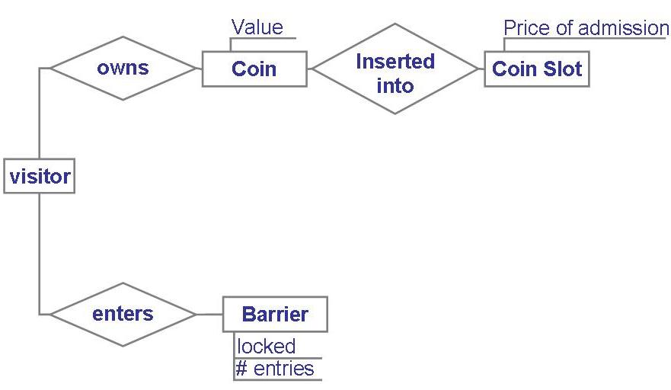
Entity-Relationship Diagrams
Entity diagram of turnstile problem

Slide 18
Entity-Relationship Diagrams
Entity diagram of turnstile problem (with Cardinality)

Slide 19
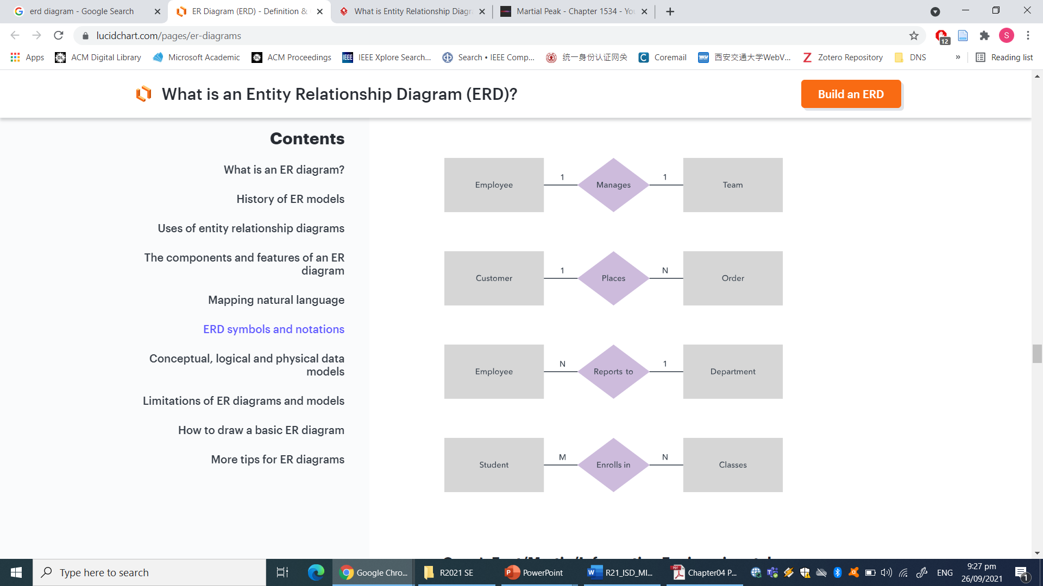
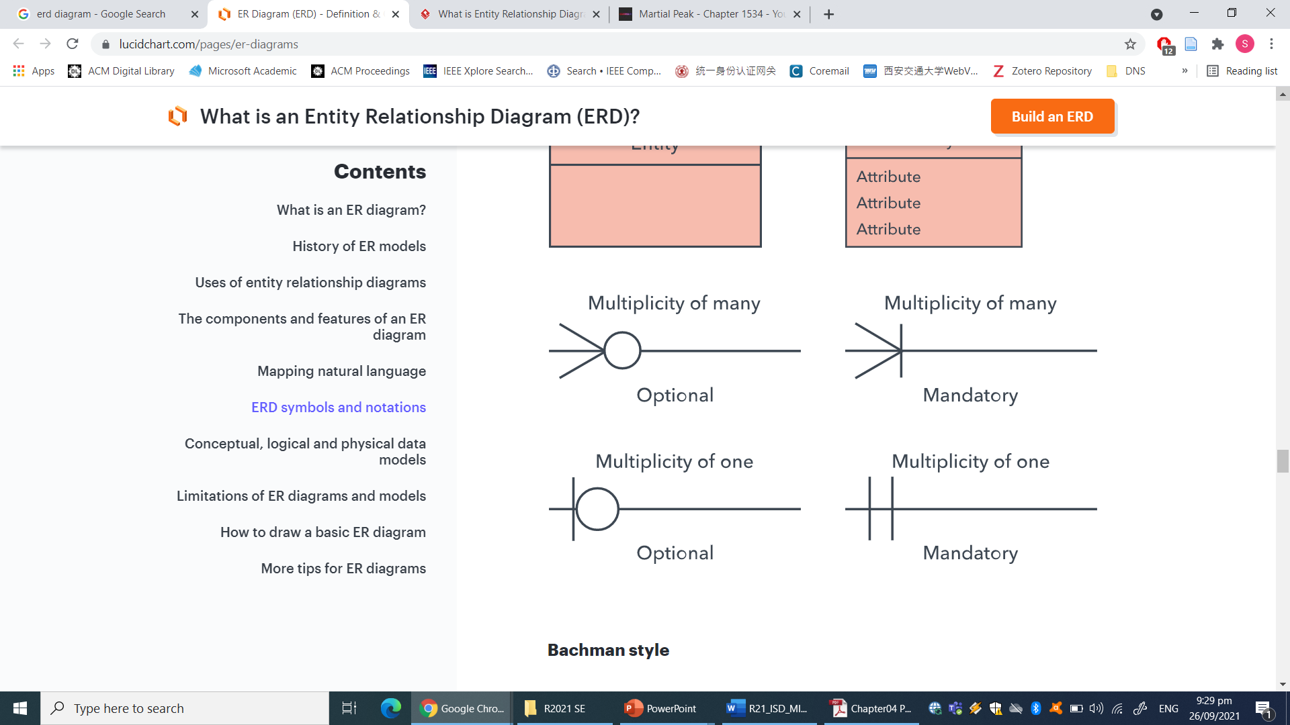
Entity Relation Diagram
Cardinality: Defines the numerical attributes of the relationship between two entities or entity sets.
The three main cardinal relationships are one-to-one, one-to-many, and many-many.
Chen notation style
Crow’s Foot/Martin/Information Engineering style

Slide 20
Entity-Relationship Diagrams
ER diagrams are popular because
they provide an overview of the problem to be addressed
the view is relatively stable when changes are made to the problem's requirements
ER diagram is likely to be used to model a problem early in the requirements process

Slide 21
Class diagram
A class diagram depicts classes and their interrelationships
Used for describing structure and behavior in the use cases
Provide a conceptual model of the system in terms of entities and their relationships
Used for requirement capture, end-user interaction
Detailed class diagrams are used for developers

Slide 22
Class Diagrams
A Class Diagram represents a system in terms of
objects: entities, organized in classes that have an inheritance hierarchy
attributes: object's variables or characteristics
methods: actions on the object's variables

Slide 23
Class diagram
Each class is represented by a rectangle subdivided into three compartments
Name
Attributes
Operations
Modifiers are used to indicate visibility of attributes and operations.
‘+’ is used to denote Public visibility (everyone)
‘#’ is used to denote Protected visibility (friends and derived)
‘-’ is used to denote Private visibility (no one)
By default, attributes are hidden and operations are visible.

Slide 24
Class diagram
Name
Account_Name
- Customer_Name
- Balance
Attributes
+addFunds( )
+withDraw( )
+transfer( )
Operations

Slide 25
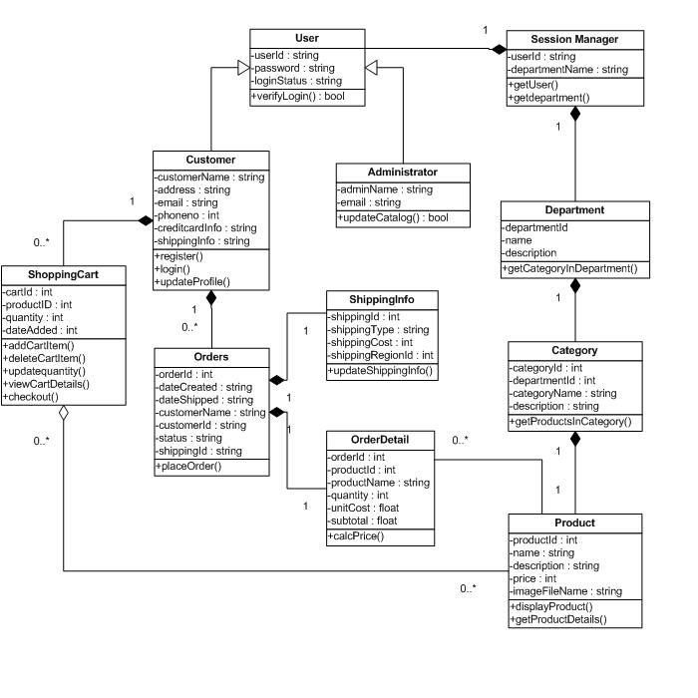

Slide 26
OO Relationships
There are two kinds of Relationships
Generalization (parent-child relationship)
Association (student enrolls in course)
Associations can be further classified as
Aggregation
Composition

Slide 27
OO Relationships: Generalization
Supertype
Example:
Customer
Regular
Customer
Loyalty
Customer
Subtype1
Subtype2
-Inheritance is a required feature of object orientation
-Generalization expresses a parent/child relationship among related classes.
Used for abstracting details in several layers

Slide 28
OO Relationships: Association
Represent relationship between instances of classes
Student enrolls in a course
Courses have students
Courses have exams
Etc.
Association has two ends
Role names (e.g. enrolls)
Multiplicity (e.g. One course can have many students)
Navigability (unidirectional, bidirectional)

Slide 29
Association: Multiplicity and Roles
student
1
*
University
Person
0..1
*
employer
teacher
Multiplicity
Symbol Meaning
1 One and only one
0..1 Zero or one
M..N From M to N (natural language)
* From zero to any positive integer
0..* From zero to any positive integer
1..* From one to any positive integer
Role
Role
“A given university groups many people; some act as students, others as teachers. A given student belongs to a single university; a given teacher may or may not be working for the university at a particular time.”

Slide 30
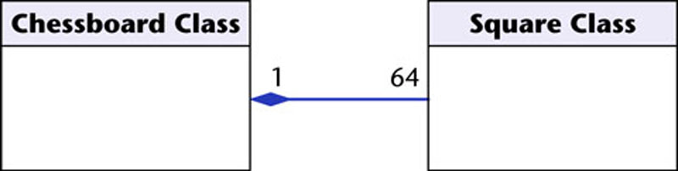
OO Relationships: Composition
Class W
Association
Models the part–whole relationship
Composition
Also models the part–whole relationship but, in addition, Every part may belong to only one whole, and If the whole is deleted, so are the parts
Example:
A number of different chess boards: Each square belongs to only one board. If a chess board is thrown away, all 64 squares on that board go as well.
Whole Class
Class P₁
Class P₂
Part Classes
[From Dr.David A. Workman]
Example
Figure 16.7
The McGraw-Hill Companies, 2005

Slide 31
OO Relationships: Aggregation
Container Class
Aggregation:
expresses a relationship among instances of related classes. It is a specific kind of Container-Containee relationship.
express a more informal relationship than composition expresses.
Aggregation is appropriate when Container and Containees have no special access privileges to each other.
Class C
AGGREGATION
Class E₁
Class E₂
Containee Classes
Example
Bag
Apples
Milk
[From Dr.David A. Workman]

Slide 32
Aggregation vs. Composition
Composition is really a strong form of association
components have only one owner
components cannot exist independent of their owner
components live or die with their owner
e.g. Each car has an engine that can not be shared with other cars.
Aggregations
may form "part of" the association, but may not be essential to it. They may also exist independent of the aggregate. e.g. Apples may exist independent of the bag.

Slide 33
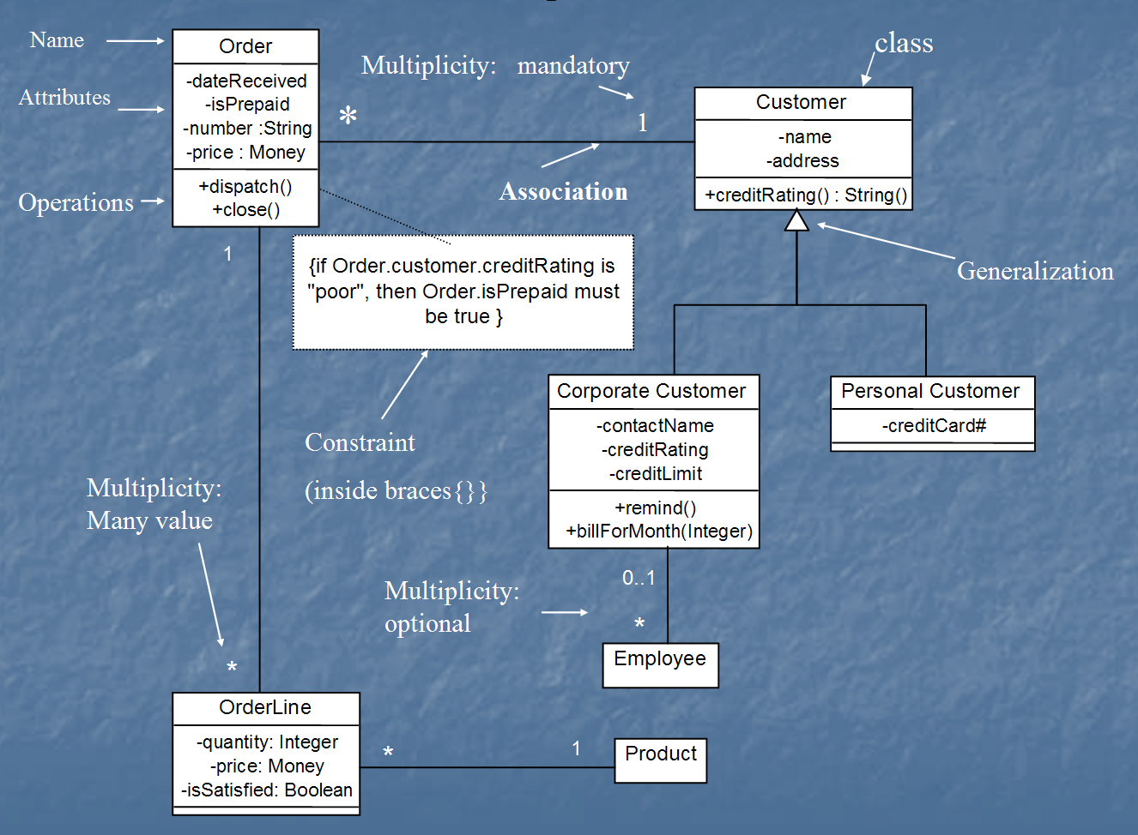
Class diagram
[from UML Distilled Third Edition]

Slide 34
Lecture

Slide 35
Data Flow Diagrams (DFD)
A graphical tool, useful for communicating with users, managers, and other personnel.
Used to perform structured analysis to determine logical requirements.
Useful for analyzing existing as well as proposed systems.
Focus on the movement of data between external entities and processes, and between processes and data stores.
A relatively simple technique to learn and use.

Slide 36
Why DFD ?
Provides an overview of-
What data a system processes
What transformations are performed
What data are stored
What results are produced and where they flow
Graphical nature makes it a good communication tool between-
User and analyst
Analyst and System designer

Slide 37

DFD elements
Source/Sinks (External entity)
Processes
Data Stores
Data flows

Slide 38
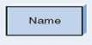
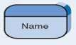
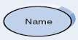
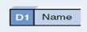
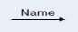
Symbols Used:
Symbol | Gane & Sarson Symbol | DeMarco & Yourdan Symbol
External Entity
Process
Data store
Data flow

Slide 39
Descriptions :
 External Entity - people or organisations that send data
into the system or receive data from the system.
 Process - models what happens to the data
i.e. transforms incoming data into outgoing data.
 Data Store - represents permanent data that is used by the system.
 Data Flow - models the actual flow of the data between
the other elements.

Slide 40
Symbol naming
External Entity → Noun
Data Flow → Names of data
Process → verb phrase
Data Store → Noun

Slide 41
External Entities
They either supply or receive data
Source – Entity that supplies data to the system.
Sink – Entity that receives data from the system.
They do not process data

Slide 42

Processes
Delivery Slip
Stores demand
note
1.
STORES
Issue Slip
1.0
Grade Detail
Grade Report
Produce Grade Report
Work or actions performed on data (inside the system)
Straight line with incoming arrows are input data flows
Straight lines with outgoing arrows are output data flows
Labels are assigned to Data flow. These aid documentation

Slide 43
Processes
Can have more than one outgoing data flow or more than one incoming data flow
1.0
Graded Work
Submitted Work
Grade Student Work
Student Grade
3.0
Hours Worked
Calculated Gross Pay
Gross Pay
Pay Rate

Slide 44
Processes
Can connect to any other symbol (including another process symbol)
Contain the business logic, also called business rules
Referred to as a black box
1.0
2.0
Inventory Change
Order
Accepted Order
Verify Order
Assemble Order

Slide 45
Data Stores
Data store
D1 |  | Data Stores
D1
Data Stores
D1
Data Stores
Writing
Reading
Data store
A Data Store is a repository of data
Data can be written into the data store. This is depicted by an incoming arrow
Data can be read from a data store. This is depicted by an outgoing arrow

Slide 46
Data Flows
Data Flow
Data in motion
Marks movement of data through the system
- a pipeline to carry data.
Connects the processes, external entities and data stores.

Slide 47
Data Flow
Generally unidirectional, If same data flows in both directions, double-headed arrow can be used.
Can represent flow between process and data store by two separate arrows
2.1
Payment Detail
 | D1 | Accounts Receivable
Post Payment
Invoice Detail

Slide 48

Decomposition Of DFD
Levels | Description | Explanation
Level 0 | Context diagram | Contains only one process
Level 1 | Overview diagram | Utilizes all four elements
Level 2 | Detailed diagram | A breakdown of a level 2 process
There is no rule as to how many levels of DFD that can be used.

Slide 49
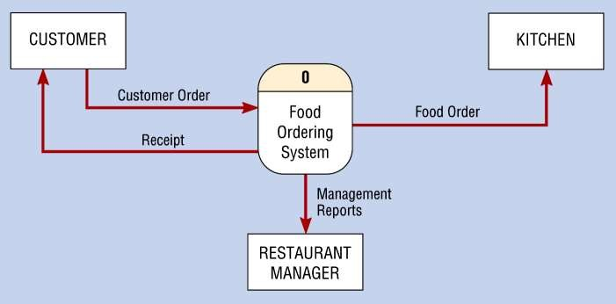
Rules for Level 0 Diagram :
 1 process represents the entire system.
 Data arrows show input and output.
 Data Stores NOT shown. They are within the system.

Slide 50
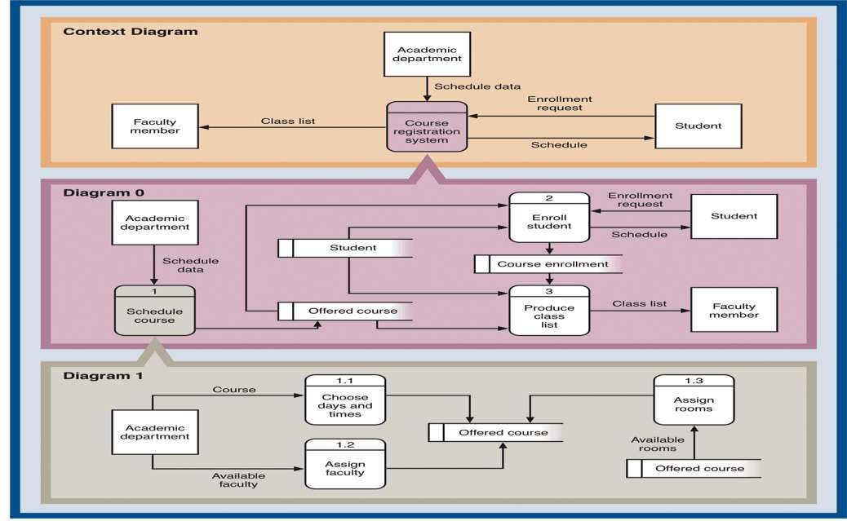
Layers of DFD Abstraction for Course Registration System
18

Slide 51
A Context Diagram (Level 0)
The major information flows between the entities and the system.
A Context Diagram addresses only one process.

Slide 52
Rules for Level 1 Diagram :
 Level 1 DFD, must balance with the context diagram it describes.
 Input going into a process are different from outputs leaving the process.
 Data stores are first shown at this level.

Slide 53
Rules for Level 2 Diagram :
 Level 2 DFD must balance with the Level 1 it describes.
 Input going into a process are different from outputs leaving the process.
 Continue to show data stores.

Slide 54
Numbering
 On level 1 processes are numbered 1,2,3…
 On level 2 processes are numbered x.1, x.2, x.3… where x is the number of the parent level 1 process.
 Number is used to uniquely identify process not to
represent any order of processing
 Data store numbers usually D1, D2, D3...

Slide 55
Rules of Data Flow
Data can flow from  Data cannot flow from
External entity to process
Process to external entity
Process to store and back
Process to process
External entity to external entity
External entity to store
Store to external entity
Store to store

Slide 56
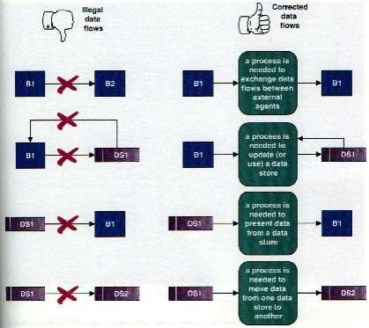
Common errors in DFD

Slide 57
DFD: Common Mistakes
Process has no data flowing into it, but has data flowing out.
Data store is hooked to external entity. This means external entity can read and write to your data file without auditing!!
The data flow goes in two directions at once. Two or more arrows should be used to show the flow to and from each process.

Slide 58
Good Style in Drawing DFD
Use meaningful names for data flows, processes and data stores.
Use top down development starting from context diagram and successively levelling DFD
Only previously stored data can be read
A process can only transfer input to output. It cannot create new data
Data stores cannot create new data

Slide 59

Creating DFDs
Create a preliminary Context Diagram.
Identify Use Cases, i.e. the ways in which users most commonly use the system.
Create DFD fragments for each use case.
Create a Level 0 diagram from fragments.
Decompose to Level 1,2,…
Validate DFDs with users.

Slide 60
Creating the Context Diagram
Draw one process representing the entire system (process 0)
Find all inputs and outputs that come from or go to external entities; draw as data flows.
Draw in external entities as the source or destination of the data flows.

Slide 61

Creating Level 0 Diagram
Combine the set of DFD fragments into one diagram.
Generally move from top to bottom, left to right.
Minimize crossed lines.

Slide 62
Creating Level 1 Diagram
Each use case is turned into its own DFD.
Take the steps listed on the use case and depict each as a process on the level 1 DFD.
Inputs and outputs listed on use case become data flows on DFD.
Include sources and destinations of data flows to processes and stores within the DFD.
May also include external entities for clarity.

Slide 63

When to stop decomposing DFDs?
Ideally, a DFD has at least three levels.
When the system becomes primitive i.e. lowest level is reached and further decomposition is useless.

Slide 64

Validating DFD
Check for syntax errors to assure correct DFD structure.
Check for semantics errors to assure accuracy of DFD relative to actual/desired system.

Slide 65









DFD for University Admission System
Context Diagram
Student Information
Report Request
Student
0
University Admission System
Staff
Admission Approval or Rejection
Report

Slide 66











Level 0
Student Information
Report Request
Student Name & ID
Student
1
3
Data Item Prompt
Staff
Admission Approval or Rejection
Perform Intake Procedure
Generate
Reports
Data Items
Data Query
Prior Application Data
Report
Approved Application
Data
D1
Student Data
Verified Approved Application
2
Maintain Student Information
Other Student Data
Request for Student Information Maintenance

Slide 67








Level 1 Process 1, Perform Intake Procedure
Student Information
Student
1.1
Admission Application
1.2
Receive Admission Application
Verify Admission Application
Student Name and ID
Verified Admission Application
Prior Application Data
D1
Student Data
Application Data
Application Request
Application Approval or Rejection
1.3
Review Admission Application
Approved Application

Slide 68








Level 1 Process 2, Maintain Student Information
Approved Application to Add
2.2
Add New
Student
Verified Approved Application
Verified Changed Student Data
2.3
Approved Application
2.1
Approved Application to Edit
Edit Existing Student
Request for Student Information Maintenance
ID of Student to Delete
D1
Student Data
Determine Operation
2.4
Delete Existing Student
Verified ID of Student to Delete
2.5
Determination to Cancel Operation
Cancel
Operation

Slide 69







DFD for Lemonade Stand
Context Diagram
CUSTOMER
Sales Forecast
Production Schedule Pay
Time Worked
EMPLOYEE
Order
Product Served Payment
0.0
Lemonade System
Received Goods Payment
Purchase Order
VENDOR

Slide 70








Level 0
1.0
Sale
Customer Order
Sales Forecast
Product Ordered Payment
2.0
CUSTOMER
Production Schedule
EMPLOYEE
Product Served
Production
Received Goods
Inventory
VENDOR
3.0
Procure- ment
Purchase Order
Payment
Order Decisions
Pay
Time Worked
4.0
Payroll

Slide 71




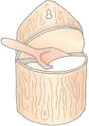
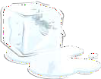

Level 1, Process 1
CUSTOMER
Customer Order
ORDER
Request for Forecast
1.1
Record Order
1.3
Produce Sales Forecast
Severed Order
Payment
Sales Forecast
1.2
Receive Payment
PAYMENT

Slide 72
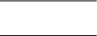







Level 1, Process 2 and Process 3
Order Decision
PURCHASE
ORDER
Product Order
3.1
Produce Purchase Order
ORDER
2.1
Serve Product
Quantity On-Hand
RAW
Quantity Severed
Quantity
MATERIALS
RAW MATERIALS
Received
Goods
Received
Production Schedule
3.2
Receive Items
2.2
Produce
Product
Quantity Used
RECEIVED ITEMS
INVENTORTY
Payment Approval
Production Data
3.3
Pay Vendor
VENDOR
2.3
Store
Product
Quantity Produced & Location Stored
Payment

Slide 73




Level 1, Process 4
Time Worked
4.1
Record Time Worked
TIME CARDS
Employee ID
EMPLOYEE
Payroll Request
4.2
Calculate Payroll
Unpaid time cards
PAYROLL
Payment Approval
4.3
Pay Employe e
PAYMENTS
Payment

Slide 74

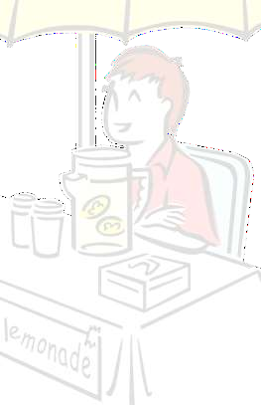














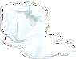





1.0
Sale
1.1
Record Order
1.2
Receive Payment
Process Decomposition
2.0
Production
2.1
Serve Product
2.2
Produce Product
2.3
Store Product
0.0
Lemonade System
3.0
Procure- ment
3.1
Produce Purchase Order
3.2
Receive Items
3.3
Pay Vendor
4.1
Record Time Worked
4.2
Calculate Payroll
4.3
Pay Employe e
4.0
Payroll
Context Level
Level 0
Level 1

Slide 75
Logical and Physical DFD
DFDs considered so far are called logical DFDs
A physical DFD is similar to a document flow diagram
It specifies who does the operations specified by the logical DFD
Physical DFD may depict physical movements of the goods
Physical DFDs can be drawn during fact gathering phase of a life cycle

Slide 76





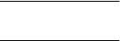
Physical DFD for Cheque Encashment
Cash
Token
Clerk
Verify A/C Signature Update Balance
Cashier Verify Token Take Signature
Cheque
CUSTOMER
Cheque with Token number
Token
Bad Cheque
Customer Accounts
Store cheques
Entry in Day Book

Slide 77












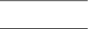
Logical DFD for Cheque Encashment
Retrieve Customer Record
Cheque
Check Balance, Issue token
Cheque with Token
Store Token no & cheques
Cheque
Customer Accounts
Token Slip or Cheque
Store cheques
CUSTOMER
Search & match token
Update Daily cash
Cheque
with token
book
Token Slip
Entry in Day Book
Cash

Slide 78
Process Hierarchy (The Broadway Entertainment Company)
In-Store System
0
Membership
1
Rental
2
Sales
3
Inventory
4
Employee
5
Enroll
1.1
Issue New Card
1.2
Reinstate
1.3
Transient
1.4
Rent
2.1
Return
2.2
Reports
2.3
Process Sales
3.1
Process Returns
3.2
Order
4.1
Receipt
4.2
Reject
4.3
Transfer
4.4
Time Reporting
5.1
Add / Delete
5.2

Slide 79
Use Case Diagram
Components
A large box: system boundary
Stick figures outside the box: actors, both human and systems
Each oval inside the box: a use case that represents some major required functionality and its variant
A line between an actor and use case: the actor participates in the use case
Use cases do not model all the tasks, instead they are used to specify user views of essential system behavior

Slide 80
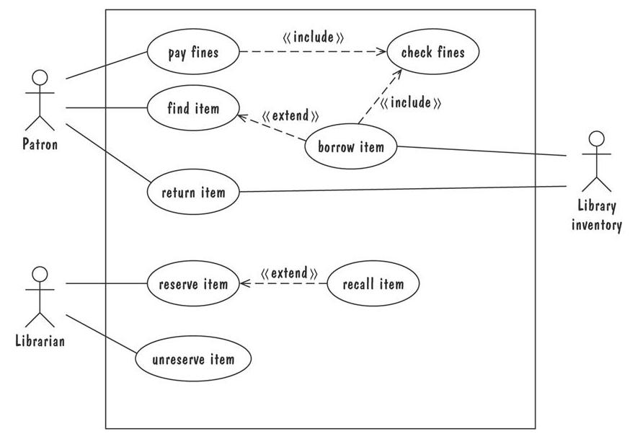
Use Case Diagram
Library use cases including borrowing a book, returning a borrowed book, and paying a library fine

Slide 81
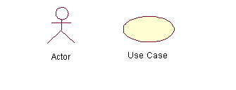
Use-Case Diagrams
Actors: A role that a user plays with respect to the system, including human users and other systems. e.g., inanimate physical objects (e.g. robot); an external system that needs some information from the current system.
Use case: A set of scenarios that describing an interaction between a user and a system, including alternatives.
System boundary: rectangle diagram representing the boundary between the actors and the system.

Slide 82
Use-Case Diagrams
Association:
communication between an actor and a use case; Represented by a solid line.
Generalization: relationship between one general use case and a special use case (used for defining special alternatives) Represented by a line with a triangular arrow head toward the parent use case.

Slide 83
Use-Case Diagrams
Include: a dotted line labeled <<include>> beginning at base use case and ending with an arrows pointing to the include use case. The include relationship occurs when a chunk of behavior is similar across more than one use case. Use “include” in stead of copying the description of that behavior.
<<include>>
Extend: a dotted line labeled <<extend>> with an arrow toward the base case. The extending use case may add behavior to the base use case. The base class declares “extension points”.
<<extend>>

Slide 84
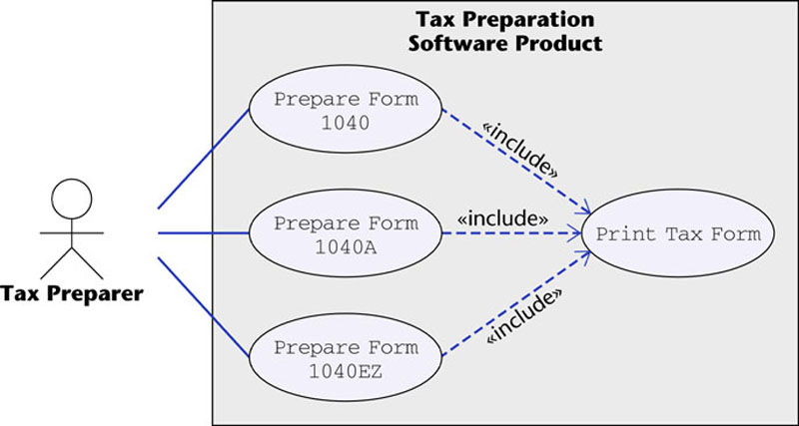
Use-Case Diagrams
Figure 16.12
The McGraw-Hill Companies, 2005

Slide 85
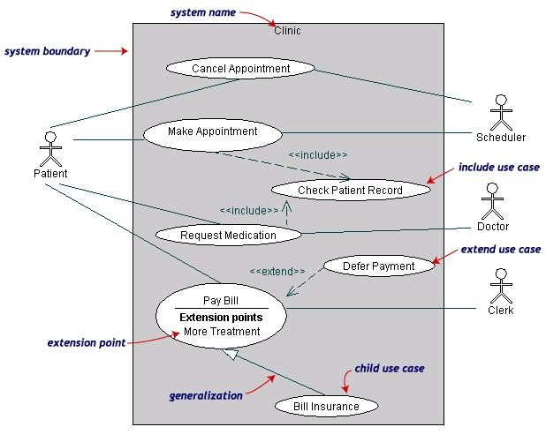
Use-Case Diagrams
Both Make Appointment and Request Medication include Check Patient Record as a subtask (include)
The extension point is written inside the base case Pay bill; the extending class Defer payment adds the behavior of this extension point. (extend)
Pay Bill is a parent use case and Bill Insurance is the child use case. (generalization)
(TogetherSoft, Inc)

Slide 86
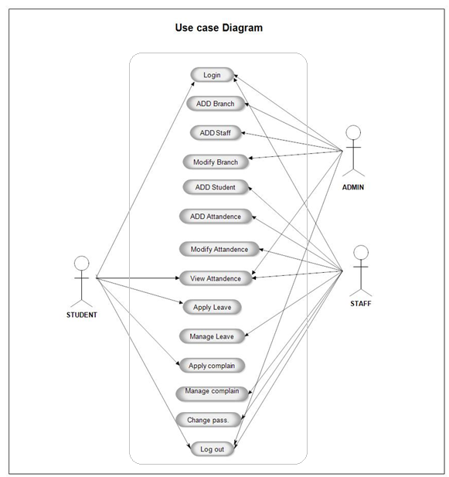
Writing Usecases
Mark Attendance Usecase
https://meeraacademy.com/use-case-diagram-student-attendance-management-system/

Slide 87
Special THANK FOR THE MATERIALS
Mr. Haroon Abdul Waheed
Mr. Sajid Saleem
Prof. Zeeshan Ali Rana
Pfleeger’s Book slides from UCF
Software Fundamentals

